Slide 1


Discrete Gaussians Modulo Sub-Lattices: New Leftover Hash Lemmas for Discrete Gaussians
Haoxiang Jin¹, Feng-Hao Liu², Zhedong Wang¹, Dawu Gu¹
¹Shanghai Jiao Tong University
²Washington State University
May 13, 2025

Slide 2
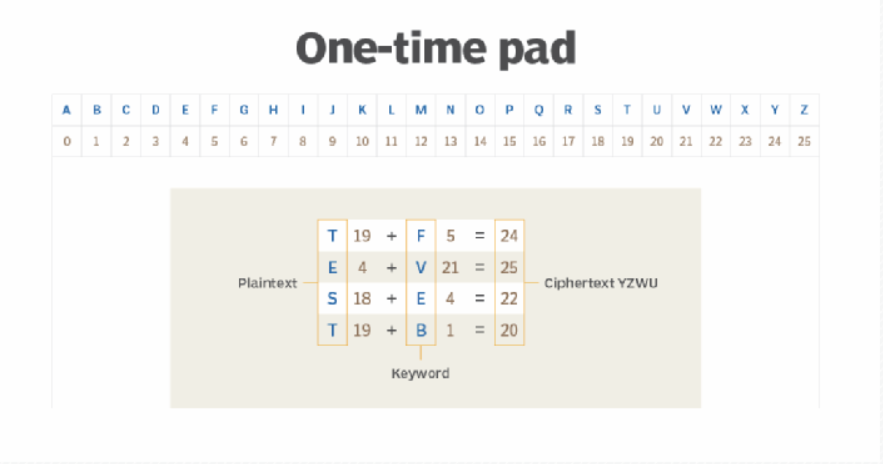
Randomness is Useful
One-time Pad
Encrypting plaintext by adding random string (mod 25)
Perfect security, i.e., guess plaintext equivalent to guess random string
Randomness is so powerful, how to obtain it?

Slide 3
Randomness Extraction
We crucially need ideal randomness in many areas. e.g. complexity theory, cryptography.
However, we often deal with imperfect randomness:
Physical sources, biometric data, partial knowledge about secrets……
Can we “extract” good randomness from ill-behaved random variables?

Slide 4
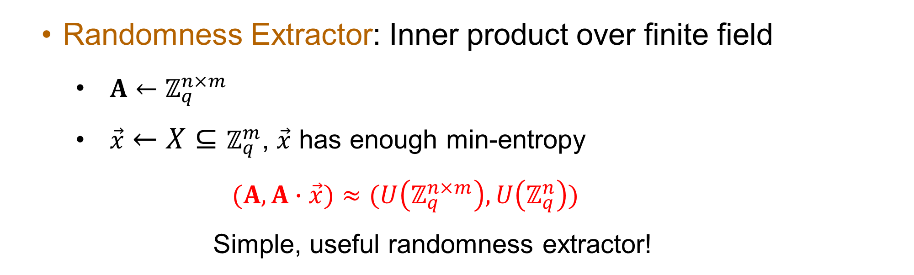
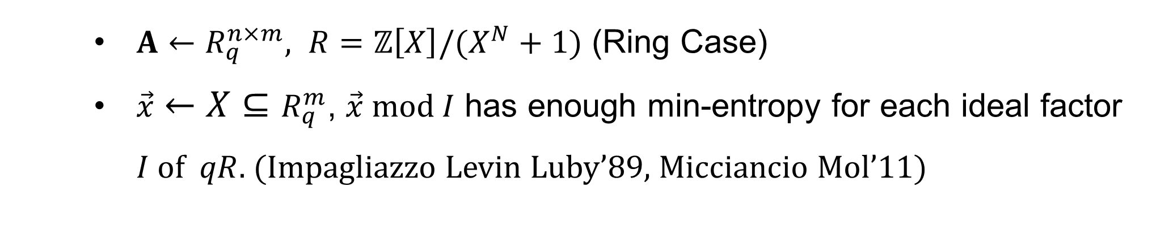
Classic Randomness Extraction: Leftover hash Lemma
Randomness Extractor: Inner product over finite field
$A←ℤ_{q}^{n×m}$
$\vec{x}←X⊆ℤ_{q}^{m}$, $\vec{x}$ has enough min-entropy
$$(A,A∙\vec{x})≈(U\left(ℤ_{q}^{n×m}\right),U\left(ℤ_{q}^{n}\right))$$
Simple, useful randomness extractor!
$A←R_{q}^{n×m}, R=ℤ\left[X\right]/(X^{N}+1)$ (Ring Case)
$\vec{x}←X⊆R_{q}^{m}$, $\vec{x} mod I$ has enough min-entropy for each ideal factor $I$ of $qR$. (Impagliazzo Levin Luby’89, Micciancio Mol’11)

Slide 5
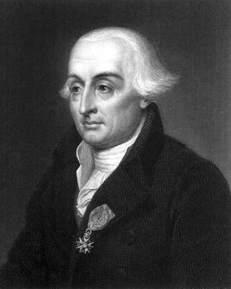
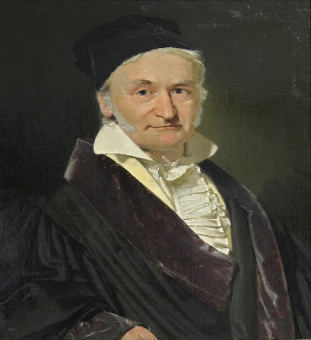
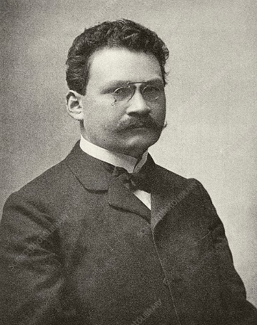
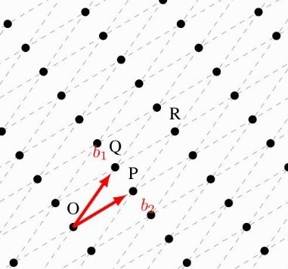
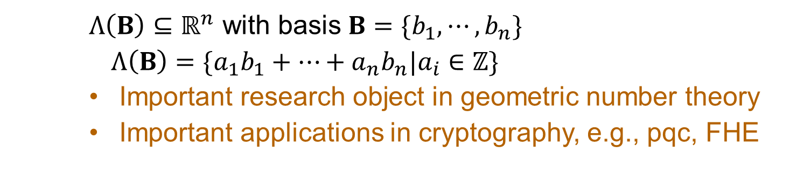
Lattice
Lattice
Lagrange Gauss Minkowski
$Λ\left(B\right)⊆ℝ^{n}$ with basis $B=\{b_{1},⋯,b_{n}\}$
$Λ\left(B\right)=\{a_{1}b_{1}+⋯+a_{n}b_{n}|a_{i}∈ℤ\}$
Important research object in geometric number theory
Important applications in cryptography, e.g., pqc, FHE

Slide 6
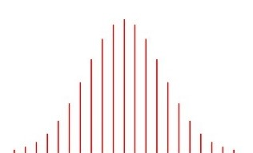
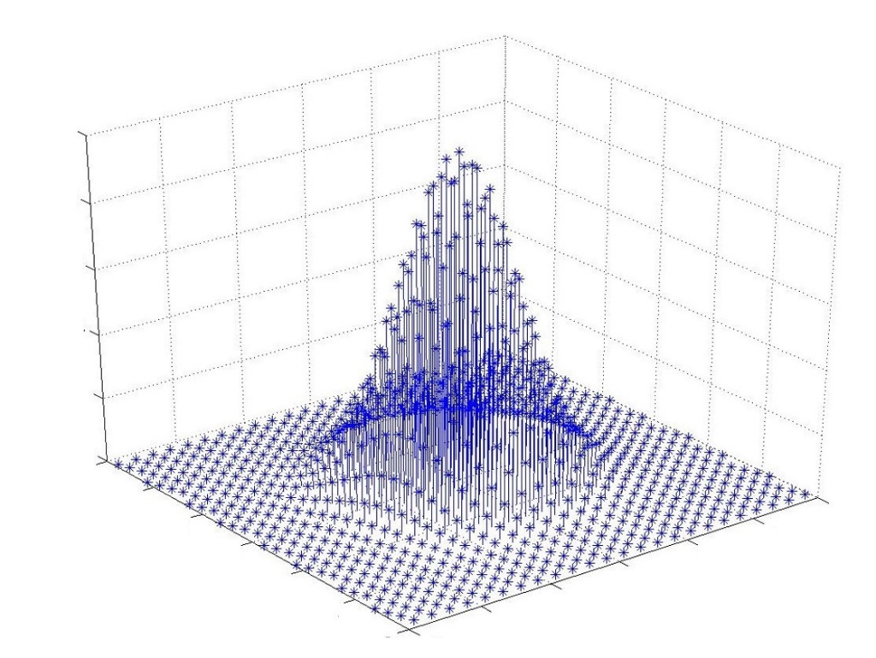
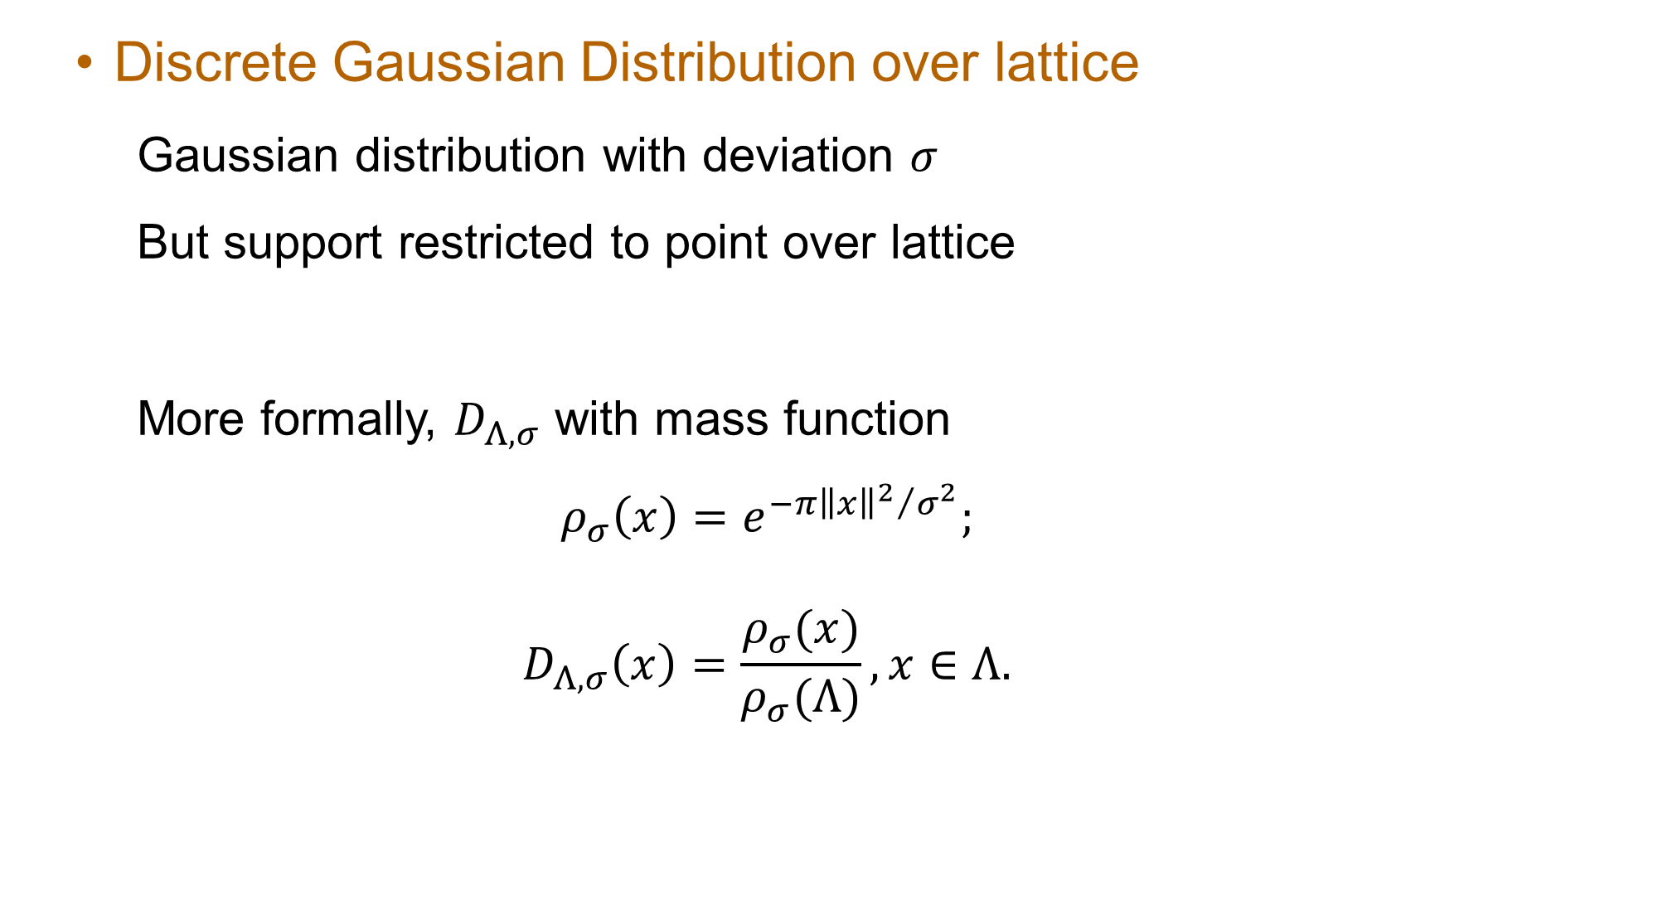
Discrete Gaussian Distribution over Lattice
Discrete Gaussian Distribution over lattice
Gaussian distribution with deviation $σ$
But support restricted to point over lattice
More formally, $D_{Λ,σ}$ with mass function
$$ρ_{σ}\left(x\right)=e^{−π{{\left\|x\right\|}^{2}}/{σ^{2}}};$$
$$D_{Λ,σ}\left(x\right)=\frac{ρ_{σ}(x)}{ρ_{σ}(Λ)}, x∈Λ.$$

Slide 7
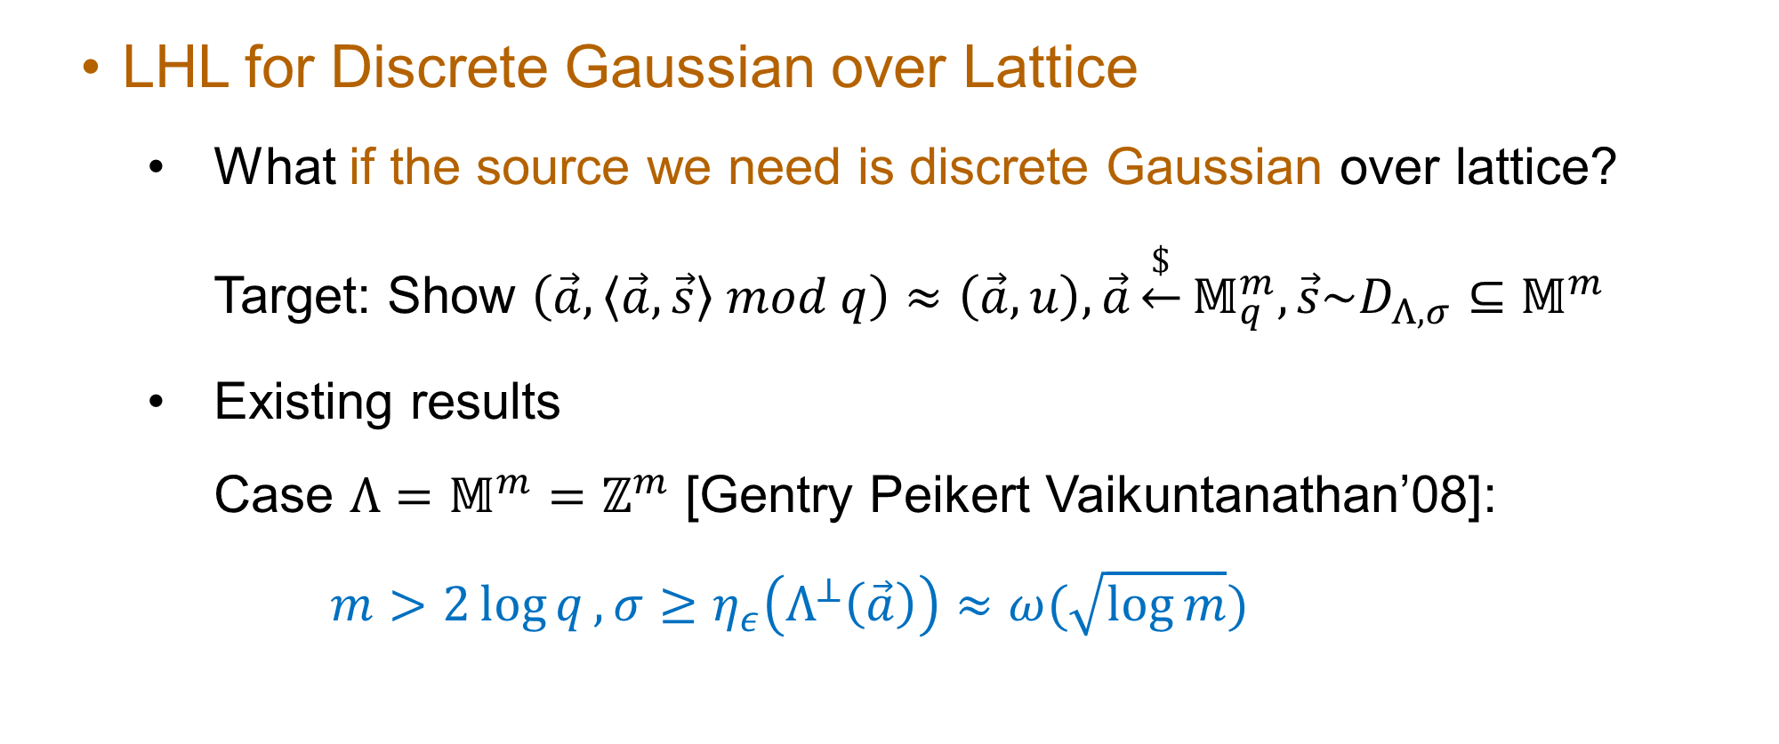
Our Focus: LHL for Discrete Gaussian over Lattice
LHL for Discrete Gaussian over Lattice
What if the source we need is discrete Gaussian over lattice?
Target: Show $\left(\vec{a},\left\langle \vec{a},\vec{s}\right\rangle mod q\right)≈\left(\vec{a},u\right),\vec{a}\underset{←}{\$}𝕄_{q}^{m}, \vec{s}\sim D_{Λ,σ}⊆𝕄^{m}$
Existing results
Case $Λ=𝕄^{m}=ℤ^{m}$ [Gentry Peikert Vaikuntanathan’08]:
$$m>2\log{q}, σ≥η_{ε}\left(Λ^{⊥}\left(\vec{a}\right)\right)≈ω(\sqrt{\log{m}})$$

Slide 8
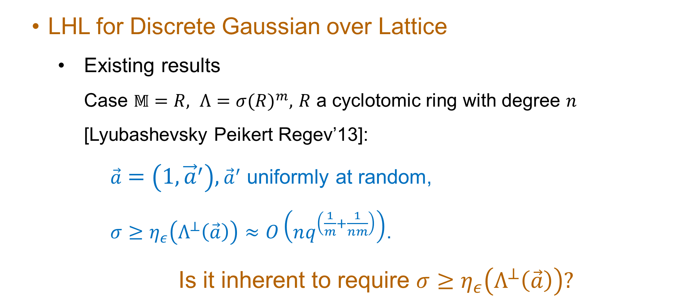
Our Focus: LHL for Discrete Gaussian over Lattice
LHL for Discrete Gaussian over Lattice
Existing results
Case $𝕄=R, Λ={σ(R)}^{m},$ $R$ a cyclotomic ring with degree $n$ [Lyubashevsky Peikert Regev’13]:
$\vec{a}=\left(1,{\vec{a}}^{′}\right),{\vec{a}}^{′}$ uniformly at random,
$σ≥η_{ε}\left(Λ^{⊥}\left(\vec{a}\right)\right)≈O\left(nq^{\left(\frac{1}{m}+\frac{1}{nm}\right)}\right)$.
Is it inherent to require $σ≥η_{ε}\left(Λ^{⊥}\left(\vec{a}\right)\right)?$

Slide 9
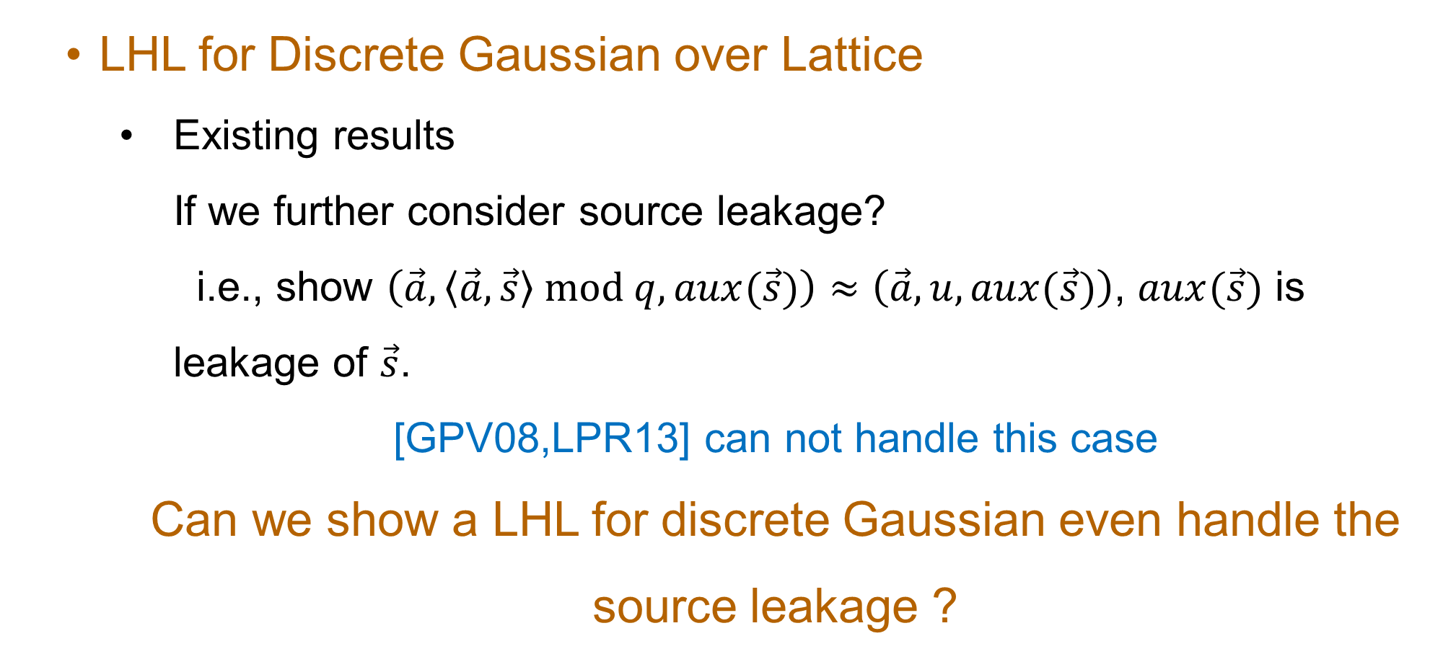
Our Focus: LHL for Discrete Gaussian over Lattice
LHL for Discrete Gaussian over Lattice
Existing results
If we further consider source leakage?
i.e., show $\left(\vec{a},\left\langle \vec{a},\vec{s}\right\rangle mod q,aux(\vec{s})\right)≈\left(\vec{a},u,aux(\vec{s})\right)$, $aux(\vec{s})$ is leakage of $\vec{s}$.
[GPV08,LPR13] can not handle this case
Can we show a LHL for discrete Gaussian even handle the source leakage ?

Slide 10

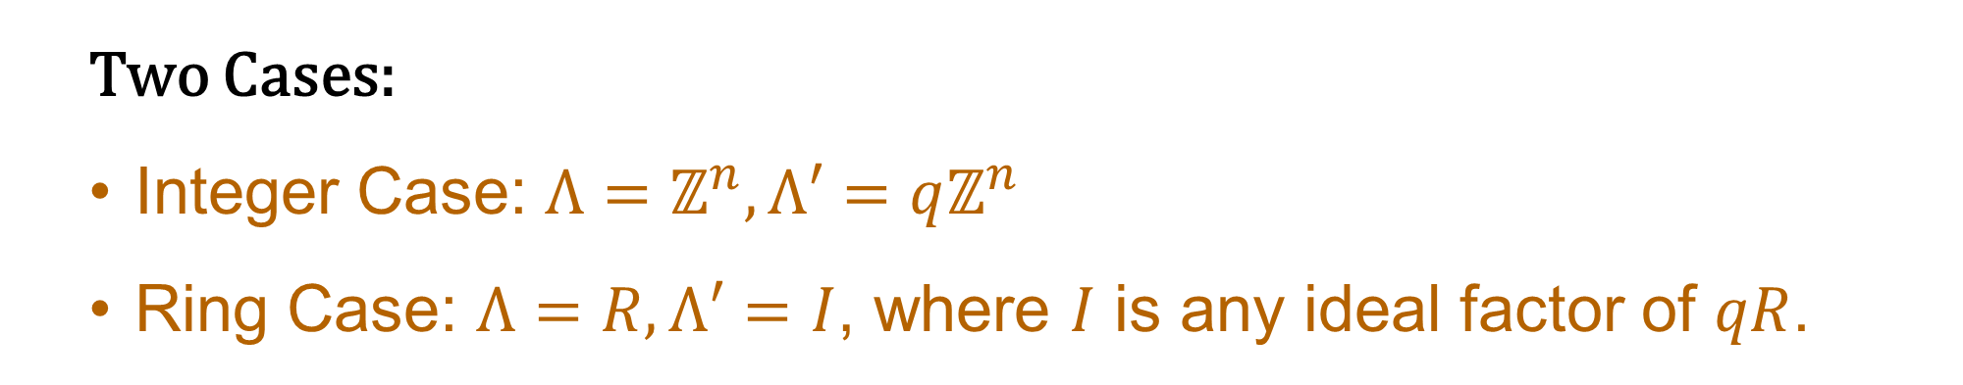
Our New LHL for Discrete Gaussian
Entropy of $D_{Λ, σ} mod Λ′$, $Λ′⊊Λ$.
Why consider discrete Gaussian modulo sub-lattice?
Two Cases:
Integer Case: $Λ=ℤ^{n},Λ′=qℤ^{n}$
Ring Case: $Λ=R, Λ′=I$, where $I$ is any ideal factor of $qR$.

Slide 11
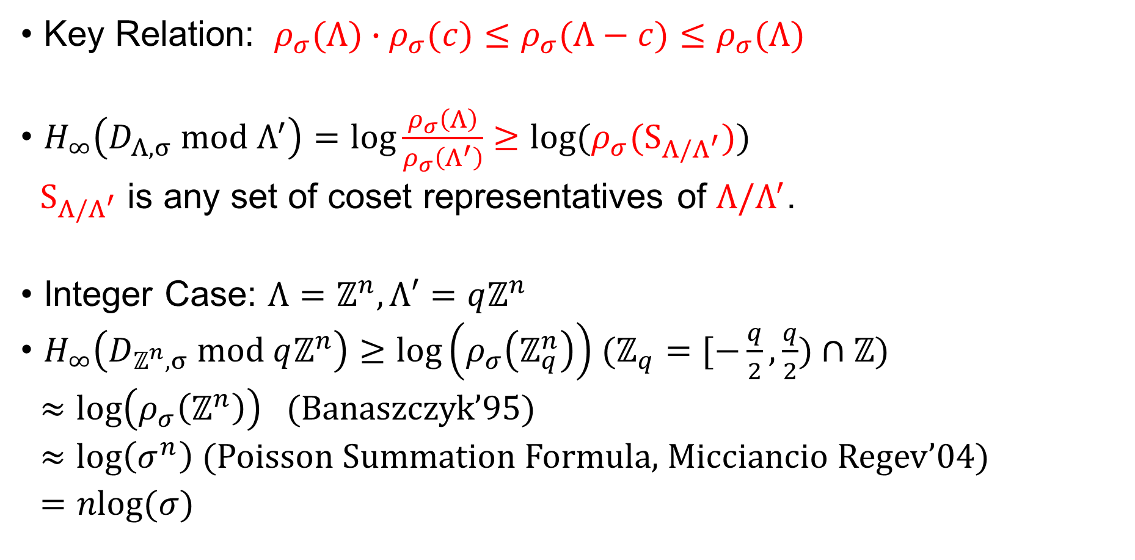
Compute the Min-Entropy
Key Relation: $ρ_{σ}(Λ)∙ρ_{σ}(c)≤ρ_{σ}(Λ−c)≤ρ_{σ}(Λ)$
$H_{∞}\left(D_{Λ, σ} mod Λ^{′}\right)=log⁡\frac{ρ_{σ}\left(Λ\right)}{ρ_{σ}\left(Λ^{′}\right)}≥log⁡(ρ_{σ}(S_{Λ/Λ^{′}}))$
$S_{Λ/Λ^{′}}$ is any set of coset representatives of $Λ/Λ^{′}$.
Integer Case: $Λ=ℤ^{n},Λ′=qℤ^{n}$
$H_{∞}\left(D_{ℤ^{n}, σ} mod qℤ^{n}\right)≥\log\left(ρ_{σ}\left(ℤ_{q}^{n}\right)\right)$ ($ℤ_{q}=[−\frac{q}{2},\frac{q}{2})∩ℤ$)
$≈\log\left(ρ_{σ}\left(ℤ^{n}\right)\right)$ (Banaszczyk’95)
$≈\log\left(σ^{n}\right)$ (Poisson Summation Formula, Micciancio Regev’04)
$=nlog(σ)$

Slide 12
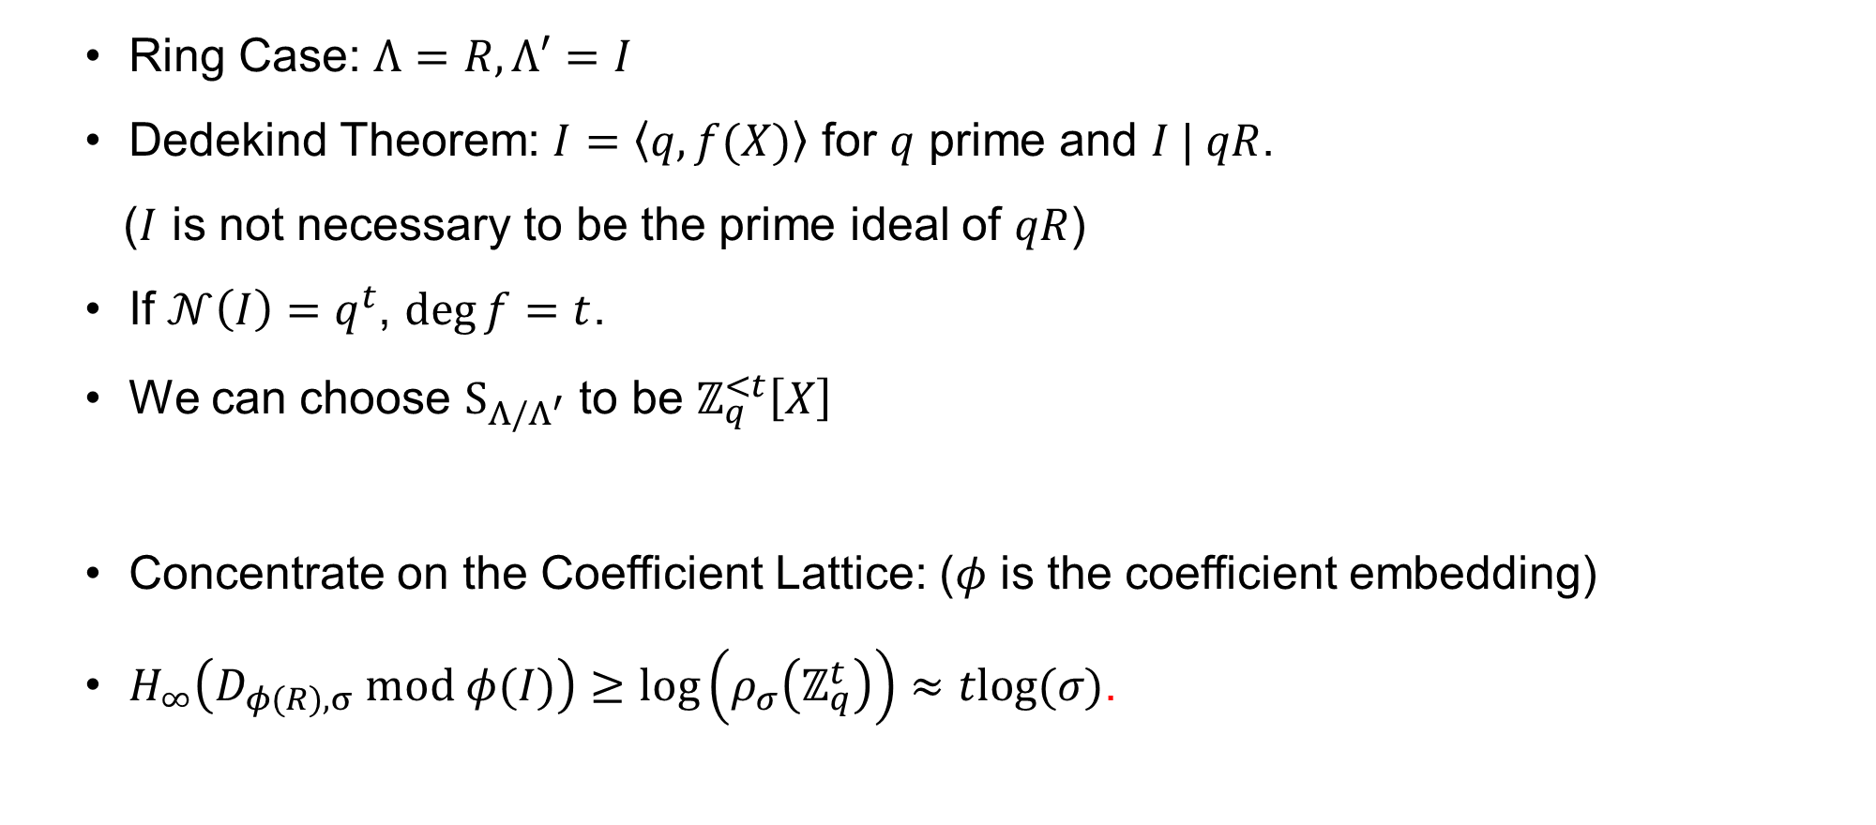
Compute the Min-Entropy
Ring Case: $Λ=R,Λ′=I$
Dedekind Theorem: $I=\left\langle q,f(X)\right\rangle$ for $q$ prime and $I | qR$.
($I$ is not necessary to be the prime ideal of $qR$)
If $𝒩\left(I\right)=q^{t}$, $\deg{f}=t$.
We can choose $S_{Λ/Λ^{′}}$ to be $ℤ_{q}^{<t}\left[X\right]$
Concentrate on the Coefficient Lattice: ($φ$ is the coefficient embedding)
$H_{∞}\left(D_{φ(R), σ} mod φ(I)\right)≥\log\left(ρ_{σ}\left(ℤ_{q}^{t}\right)\right)≈tlog(σ)$.

Slide 13
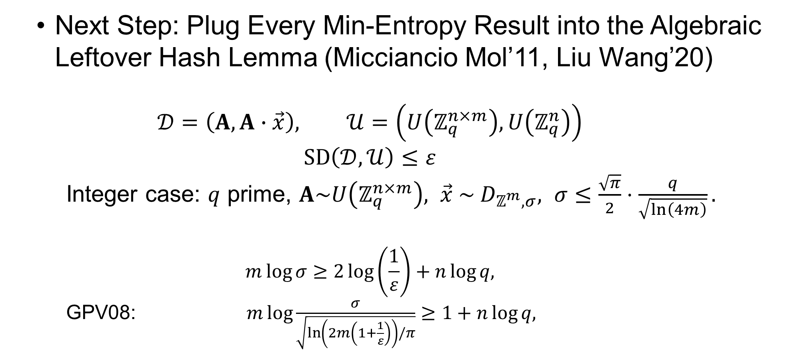

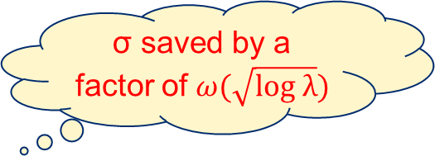
Our New LHL for Discrete Gaussian Distribution
Next Step: Plug Every Min-Entropy Result into the Algebraic Leftover Hash Lemma (Micciancio Mol’11, Liu Wang’20)
$$𝒟=\left(A,A∙\vec{x}\right), 𝒰=\left(U\left(ℤ_{q}^{n×m}\right),U\left(ℤ_{q}^{n}\right)\right)$$
$$SD\left(𝒟,𝒰\right)≤ε$$
Integer case: $q$ prime, $A\sim U\left(ℤ_{q}^{n×m}\right), \vec{x} \sim D_{ℤ^{m},σ}, σ≤\frac{\sqrt{π}}{2}⋅\frac{q}{\sqrt{\ln\left(4m\right)}}.$
$$m\log{σ}≥2\log\left(\frac{1}{ε}\right)+n\log{q,}$$
GPV08: $m\log{\frac{σ}{\sqrt{\ln\left(2m\left(1+\frac{1}{ε}\right)\right)/π}}}≥1+n\log{q,}$
Trade-off between $m, n$ and $σ$
σ saved by a factor of$ω(\sqrt{log λ})$

Slide 14
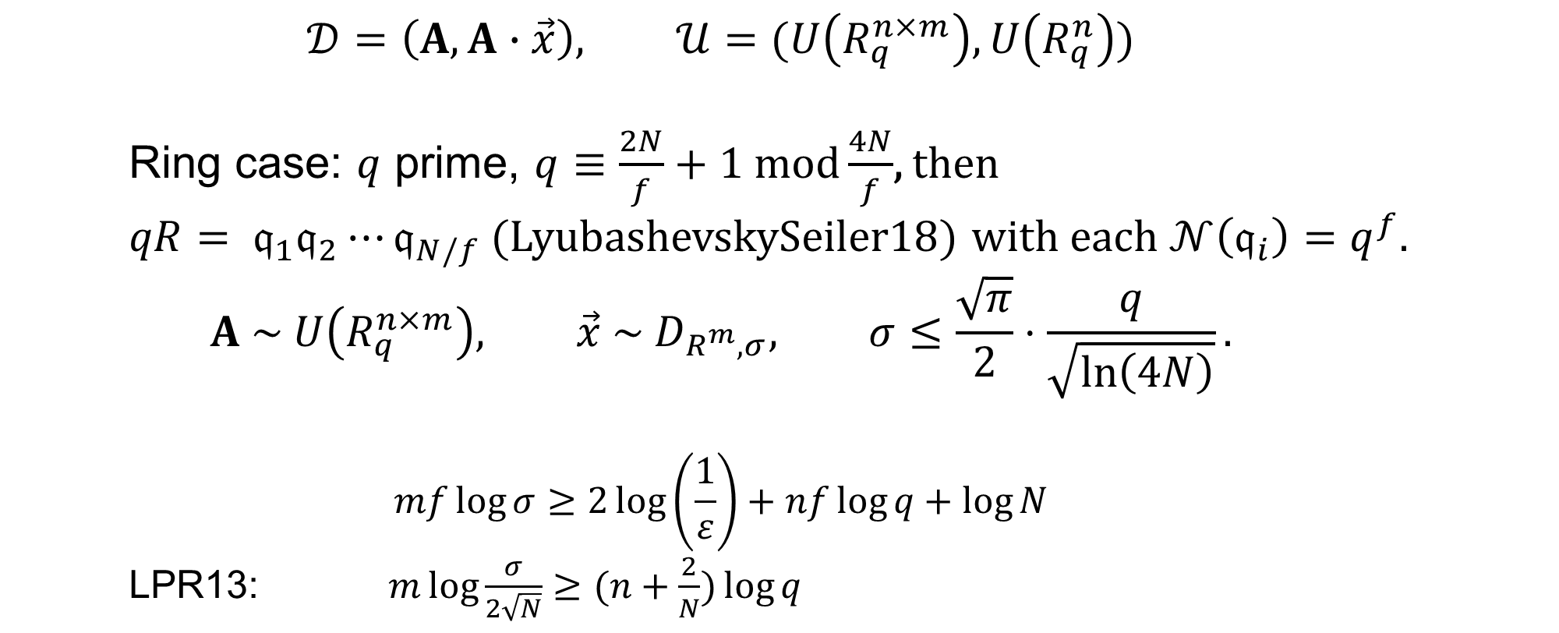
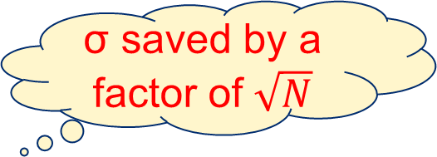

Our New LHL for Discrete Gaussian Distribution
$$𝒟=\left(A,A∙\vec{x}\right), 𝒰=(U\left(R_{q}^{n×m}\right),U\left(R_{q}^{n}\right))$$
Ring case: $q$ prime, $q≡\frac{2N}{f}+1 mod\frac{4N}{f}$, then
$qR= 𝔮_{1}𝔮_{2}⋯𝔮_{N/f}$ (LyubashevskySeiler18) with each $𝒩\left(𝔮_{i}\right)=q^{f}.$
$$A \sim U\left(R_{q}^{n×m}\right), \vec{x} \sim D_{R^{m},σ}, σ≤\frac{\sqrt{π}}{2}⋅\frac{q}{\sqrt{\ln\left(4N\right)}}.$$
$$mf\log{σ}≥2\log\left(\frac{1}{ε}\right)+nf\log{q}+\log{N}$$
LPR13: $m\log{\frac{σ}{2\sqrt{N}}}≥(n+\frac{2}{N})\log{q}$
Trade-off between $m, f, n$ and $σ$
σ saved by a factor of $\sqrt{N}$

Slide 15
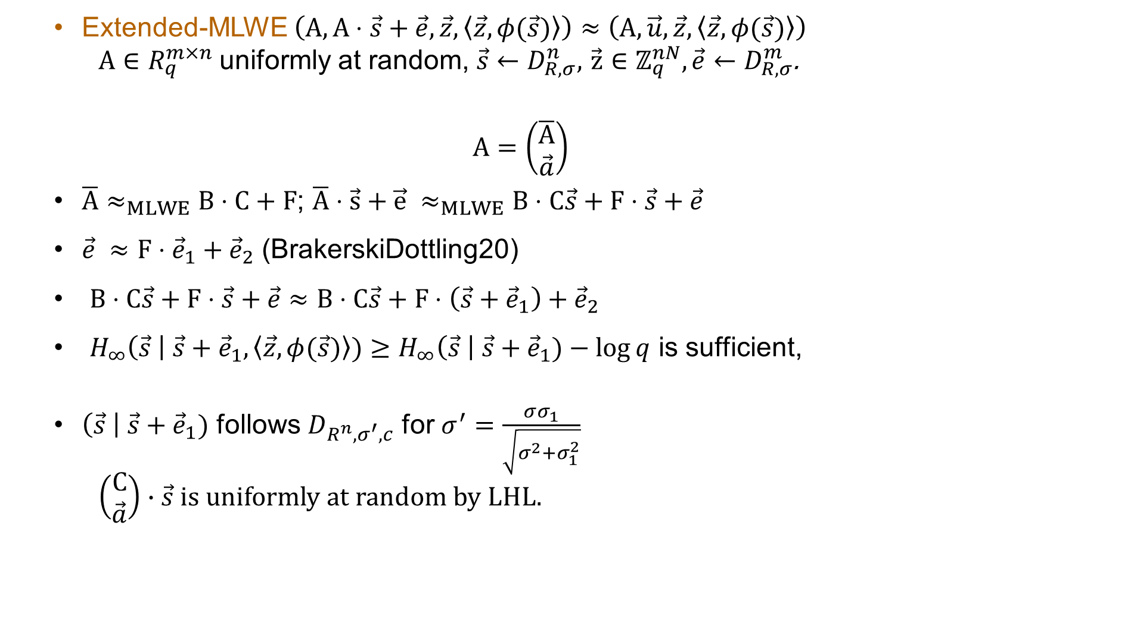
Application: Hardness of Extended-MLWE
Extended-MLWE $\left(A,A⋅\vec{s}+\vec{e},\vec{z}, \left\langle \vec{z},φ(\vec{s})\right\rangle \right)≈\left(A, \vec{u},\vec{z}, \left\langle \vec{z},φ(\vec{s})\right\rangle \right)$
$A∈R_{q}^{m×n}$uniformly at random, $\vec{s}←D_{R,σ}^{n},$ $\vec{z}∈ℤ_{q}^{nN},\vec{e}←D_{R,σ}^{m}$.
$$A=\left(\begin{matrix}\overline{A} \\ \vec{a}\end{matrix}\right)$$
$\overline{A}≈_{MLWE}B⋅C+F$; $\overline{A}⋅\vec{s}+\vec{e} ≈_{MLWE}B⋅C\vec{s}+F⋅\vec{s}+\vec{e}$
$\vec{e} ≈F⋅{\vec{e}}_{1}+{\vec{e}}_{2}$ (BrakerskiDottling20)
$B⋅C\vec{s}+F⋅\vec{s}+\vec{e}≈B⋅C\vec{s}+F⋅\left(\vec{s}+{\vec{e}}_{1}\right)+{\vec{e}}_{2}$
$H_{∞}\left(\vec{s} \right| \vec{s}+{\vec{e}}_{1},\left\langle \vec{z},φ(\vec{s})\right\rangle )≥H_{∞}\left(\vec{s} \right| \vec{s}+{\vec{e}}_{1})−\log{q}$ is sufficient,
$\left(\vec{s} \right| \vec{s}+{\vec{e}}_{1})$ follows $D_{R^{n}, σ^{′}, c}$ for $σ^{′}=\frac{σσ_{1}}{\sqrt{σ^{2}+σ_{1}^{2}}}$
$\left(\begin{matrix}C \\ \vec{a}\end{matrix}\right)∙\vec{s}$ is uniformly at random by LHL.

Slide 16
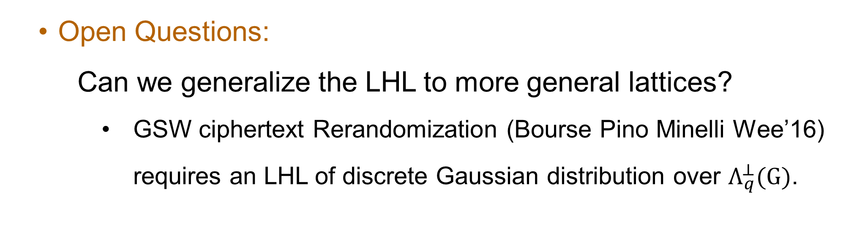
Open Questions
Open Questions:
Can we generalize the LHL to more general lattices?
GSW ciphertext Rerandomization (Bourse Pino Minelli Wee’16) requires an LHL of discrete Gaussian distribution over $Λ_{q}^{⊥}(G)$.

Slide 17

Thanks for your attention！
ia.cr/2024/1695

